Slide 1
Strategies for Breaking the Monolith
Jason van Brackel, Director of Community
Rancher Labs

Slide 2

Jason van Brackel
Twitter: jasonvanbrackel
Github: jasonvanbrackel
Slack: @jvb
philly-dev
techbash
rancher-users
kubernetes

Slide 3
Agenda
Let’s Talk Monoliths
Why?
Strategies that May Work, but Often Don’t
Evolution Not Revolution
An Example

Slide 4
Monoliths
Advantages
Disadvantages
Are simple to develop and maintain
Tend to scale better horizontally, than vertically
Massive Scale, tends towards massive dollars
Tightly Coupled Design

Slide 5
Why Break the Monolith
Business Needs Evolve
Production software needs to serve the business

Slide 6
Strategies That May Work, but probably won’t
Rewrite the Software, with a new team
Rewrite the Software, with the same team

Slide 7
Rewrite the Software, With a New Team
Advantage
Disadvantage
Won’t make the same mistakes as the old team
Will make all new mistakes

Slide 8
Rewrite the Software, With a New Team
Advantage
Disadvantage
Can take a fresh look at an old problem
Have no technical SMEs

Slide 9
Why Do These Fail?
Scope Creep
Lack of Expertise, in the Business
Relationships
Culture
Morale

Slide 10
Rewrite the Software, With the Same Team
Advantage
Disadvantage
Won’t make the same mistakes as the old team
Will make all new mistakes

Slide 11
Rewrite the Software, With the Same Team
Advantage
Disadvantage
Allows for parallel development
Features will diverge
Scope
Teams’ skills don’t level up together

Slide 12
Why Do These Fail?
Scope Creep
Business Pressure
Morale

Slide 13
Evolution Not Revolution
Keep the Band Together
Level Up Together
Keep the Business Happy
Production Application Can Evolve

Slide 14
Anti-Corruption Layer
Domain-Driven Design: Tackling Complexity in the Heart of Software, By Eric Evans 2004
Create an isolating layer to provide clients with functionality in terms of their own domain model.
The layer talks to the other system through its existing interface, requiring little or no modification to the other system.
Internally, the layer translates in both directions as necessary between the two models.

Slide 15
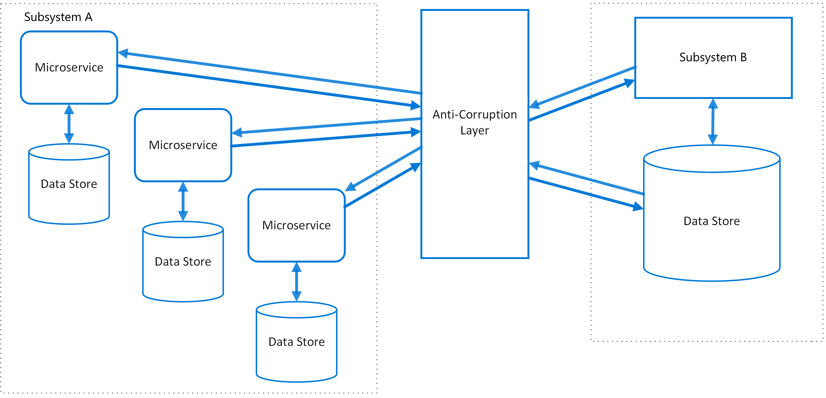
Anti-Corruption Layer
https://docs.microsoft.com/en-us/azure/architecture/patterns/anti-corruption-layer

Slide 16
https://docs.microsoft.com/en-us/azure/architecture/patterns/anti-corruption-layer

Slide 17
Goals
Allow New Systems to Integrate with the Old
Allow the Monolith to be the Monolith for as long as it has to be
Replace Monolith functionality, a little at a time
Allow new and old systems to work together

